Slide 1
Tutorial for Using KEHRMIT Analysis Code in MATLAB
2022-Oct-31
Chistol Lab
%run these functions in this order
%the code was written and tested on Windows 10 computers, best if used with a 20-inch screen or larger
%the code does not run well on Macs ☹
>> SetRawDataPath % pick the folder where the drift-corrected TIFF files are stored
>> SetAnalysisPath % pick the folder where the analysis results files will be saved
>> SelectMolecules_KEHRMITandPHADE(‘KEHRMIT+PHADE’) %select molecules for a KEHRMIT + PHADE/CIDER experiment
>> SelectMolecules_KEHRMITandPHADE(‘KEHRMIT’) %select molecules for a KEHRMIT only experiment
>> SelectMolecules_KEHRMITandPHADE('PHADE’) %select molecules for a PHADE/CIDER only experiment
>> SelectKymoROI_KEHRMITandPHADE %inspect individual kymograms, use only after selecting the molecules

Slide 2
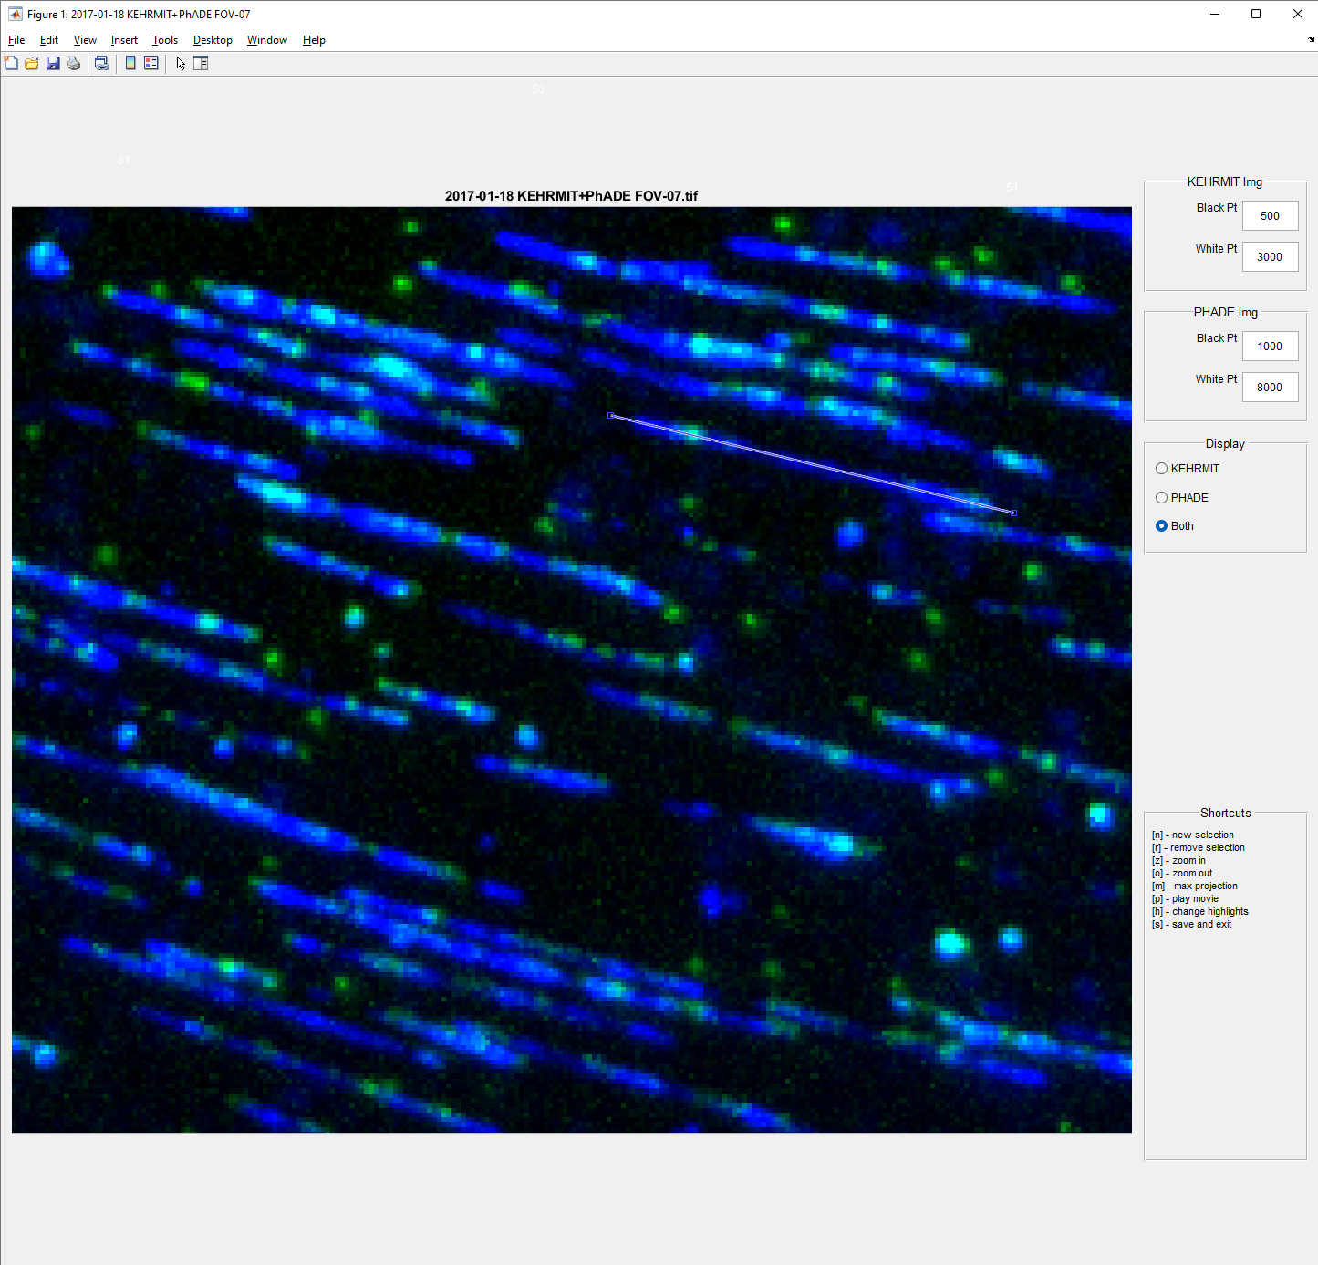
Using SelectMolecules_KEHRMITandPHADE(‘KEHRMIT+PHADE’)
Use the Black/White Point text boxes to adjust image contrast.
If the signal is too bright increase the White Pt
If the background is too bright, increase the Black Pt

Slide 3

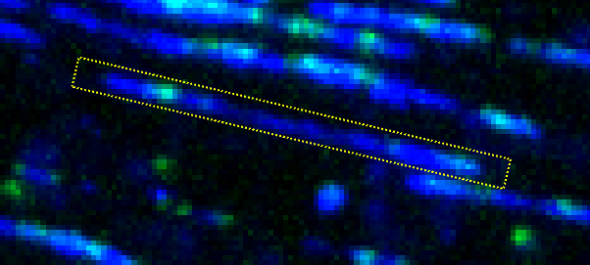
Using SelectMolecules_KEHRMITandPHADE(‘KEHRMIT+PHADE’)
Use keyboard shortcuts to execute various commands
To play the movie, press p (make sure to click on the figure first)
To select a new molecule, press n and draw a line over each individual molecule
After selecting the new molecule, the selection will appear as a line
Press h to change the selection style to a box

Slide 4
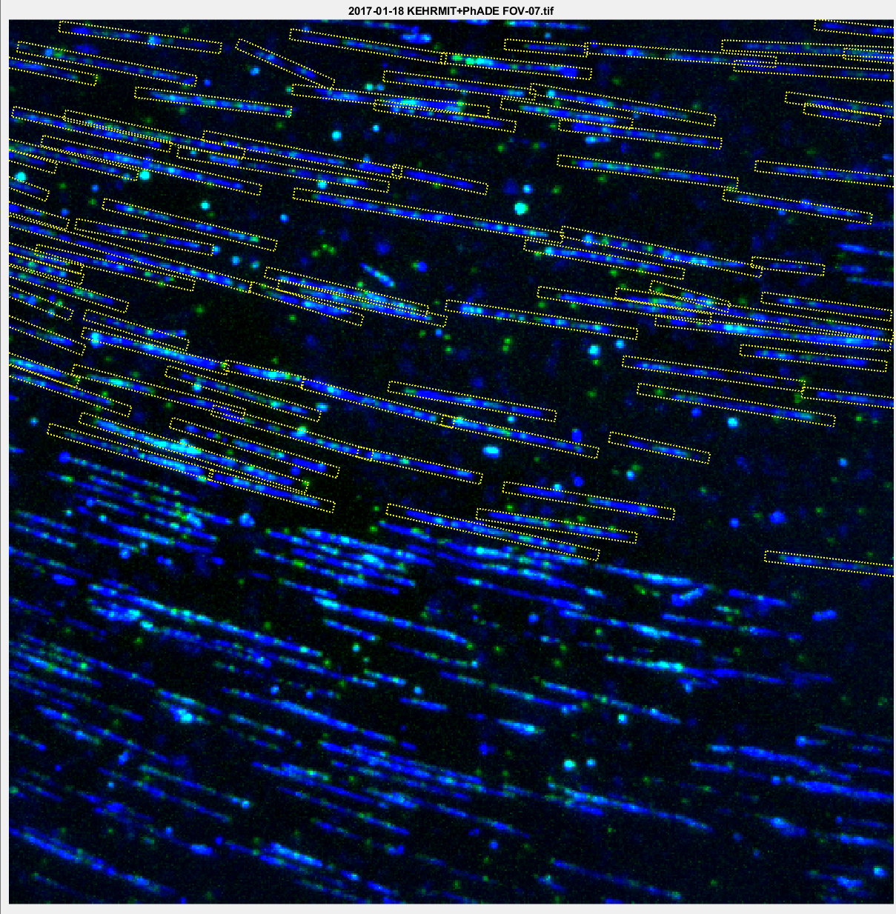
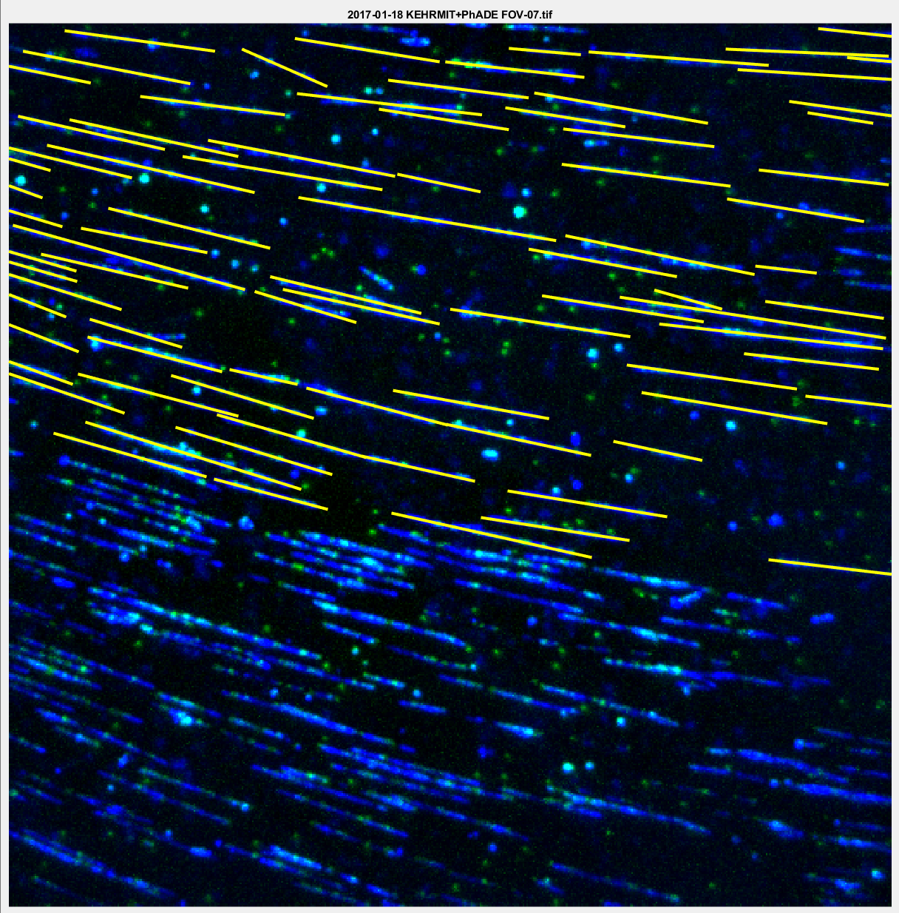
Using SelectMolecules_KEHRMITandPHADE(‘KEHRMIT+PHADE’)
Here is an example where all molecues were selected in the top half of the movie
Press s on the keyboard to save the selections and exit.
Next time you open the same movie, previously saved selections will be loaded

Slide 5
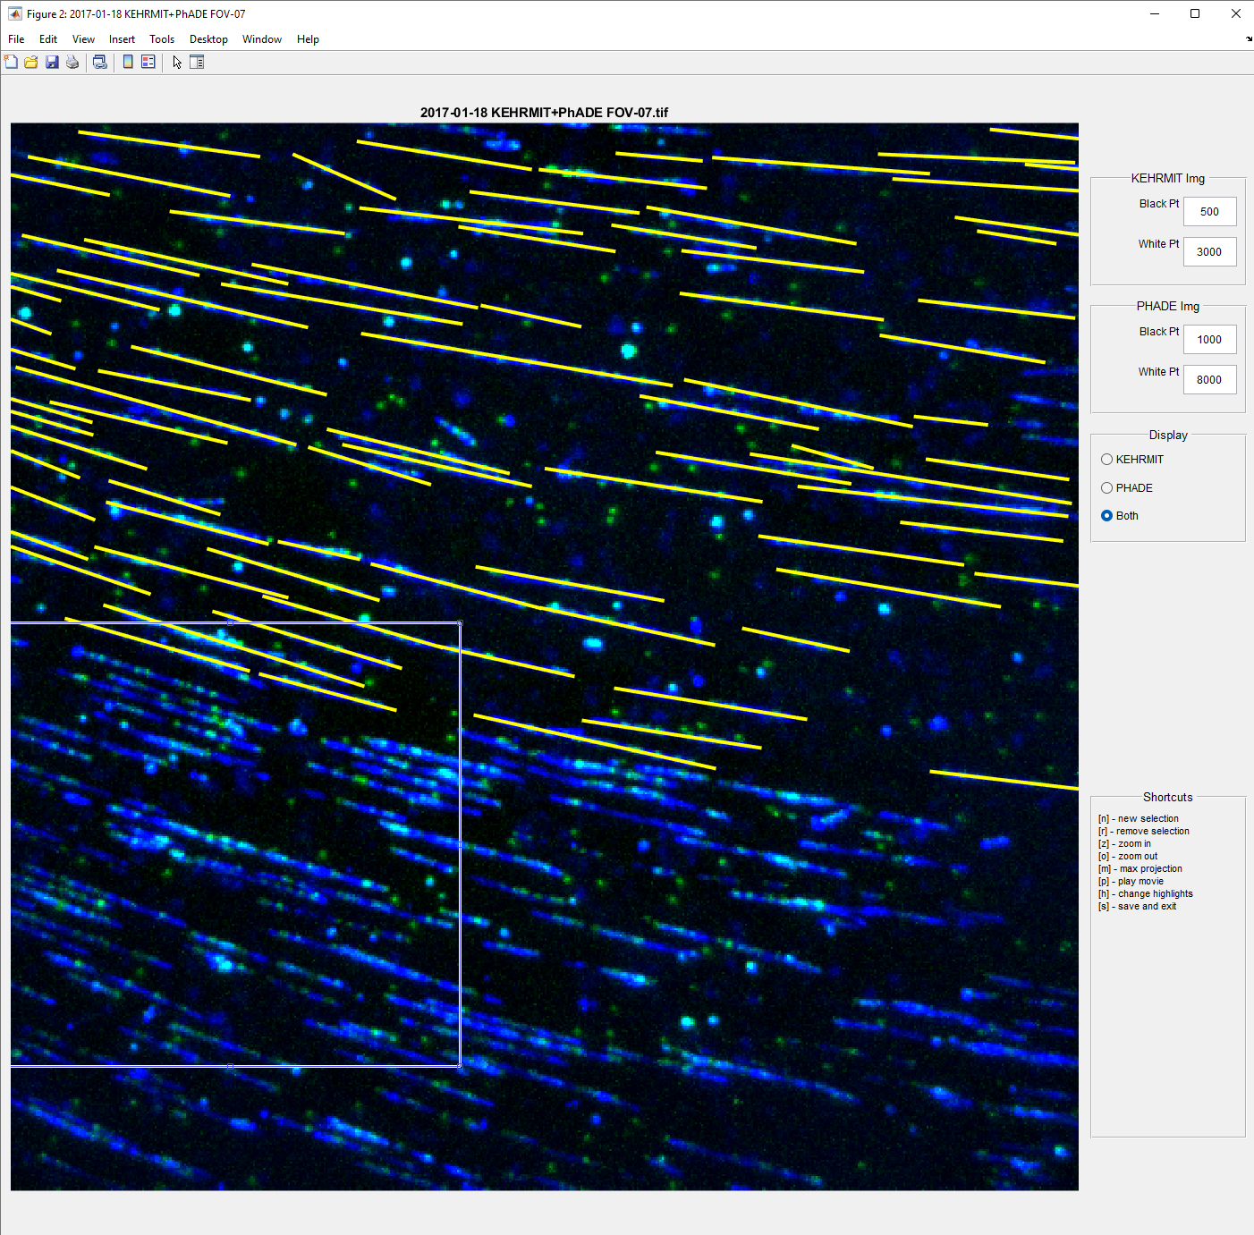
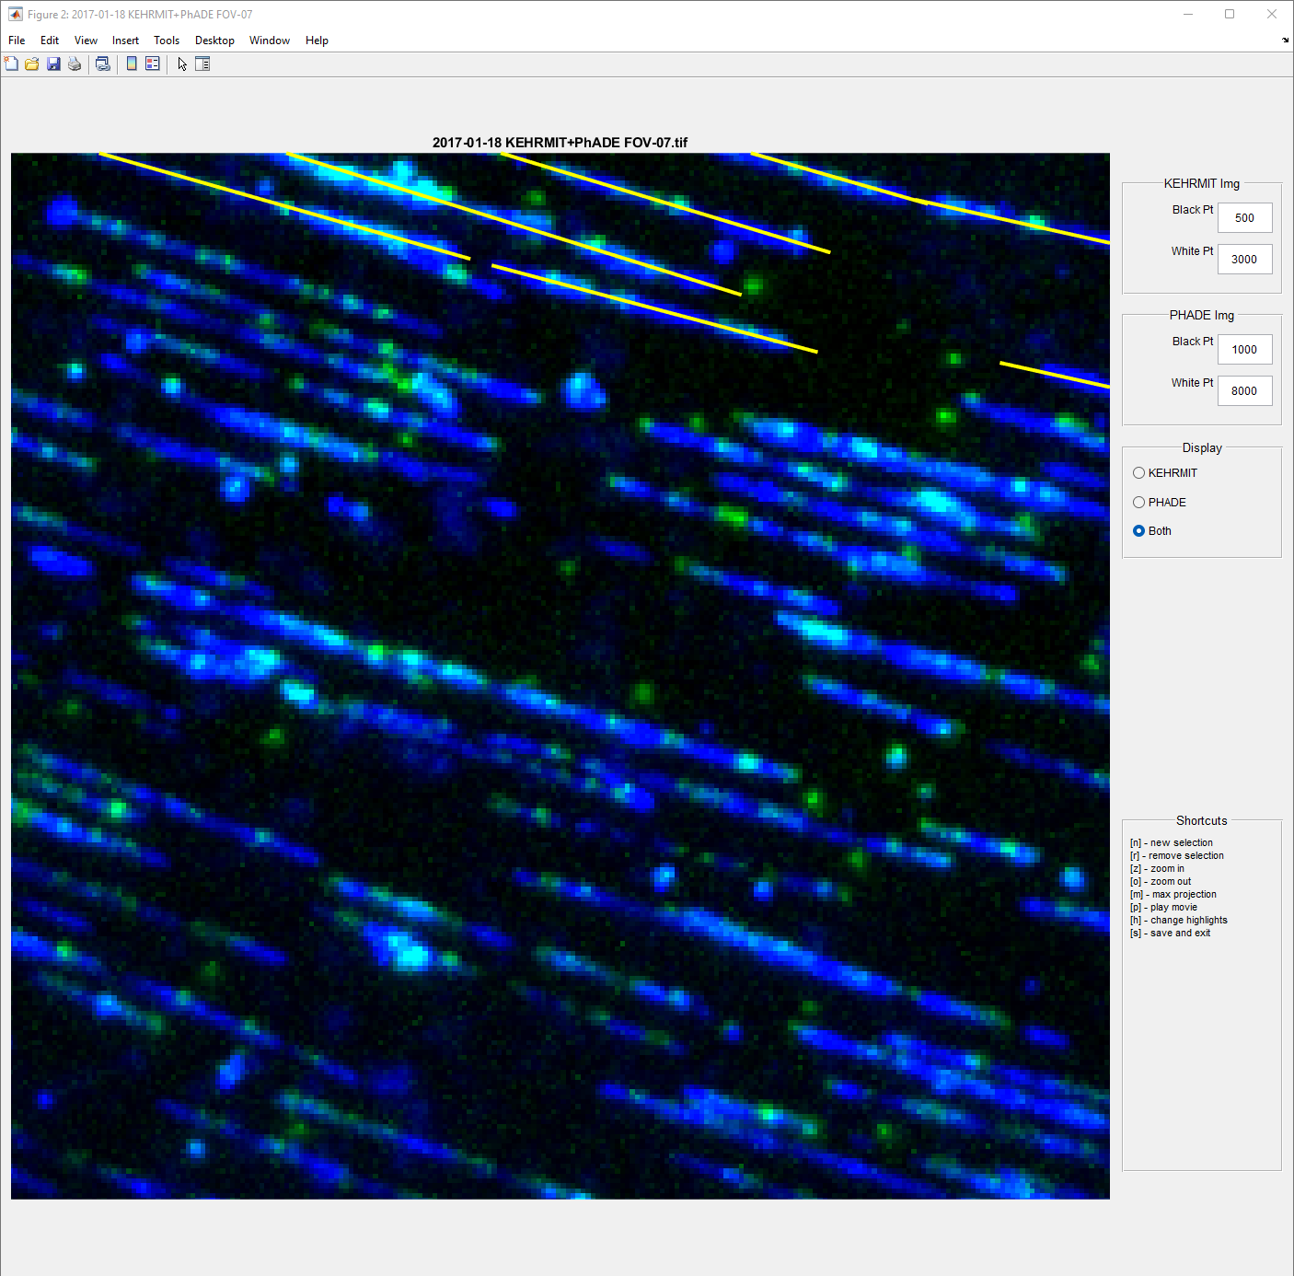
Using SelectMolecules_KEHRMITandPHADE(‘KEHRMIT+PHADE’)
Press z on the keyboard to zoom into a region (draw a recrangle to specify area)
Press o to zoom out

Slide 6
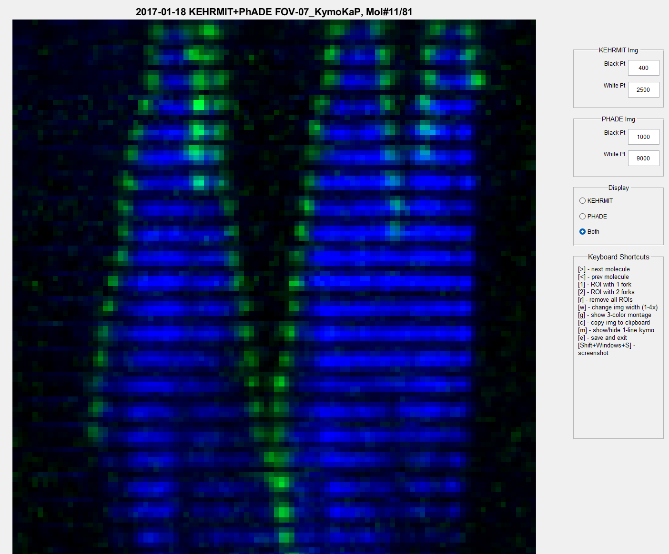
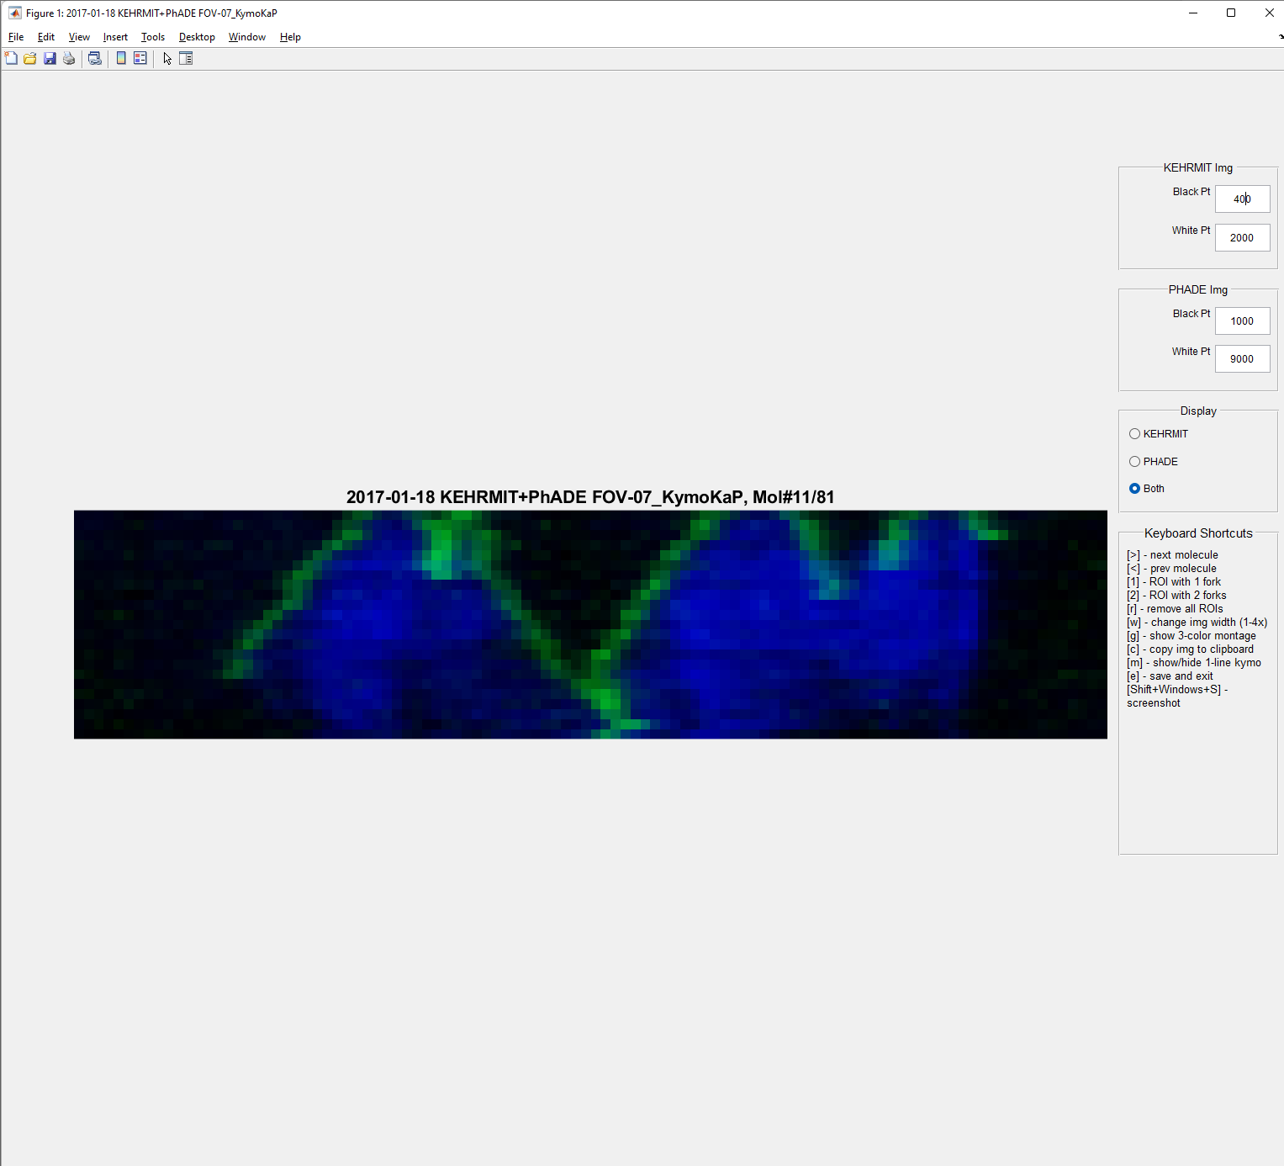
Using SelectKymoROI_KEHRMITandPHADE
Adjust Black Pt and White Pt for each channel
Use < and > arrows on the keyboard to navigate to the prev or next molecule
Press w to adjust the width of the image (1x to 4x)
Press m to change the kymogram mode to “one line” mode or back
Kymogram shown in “one line” mode

Slide 7
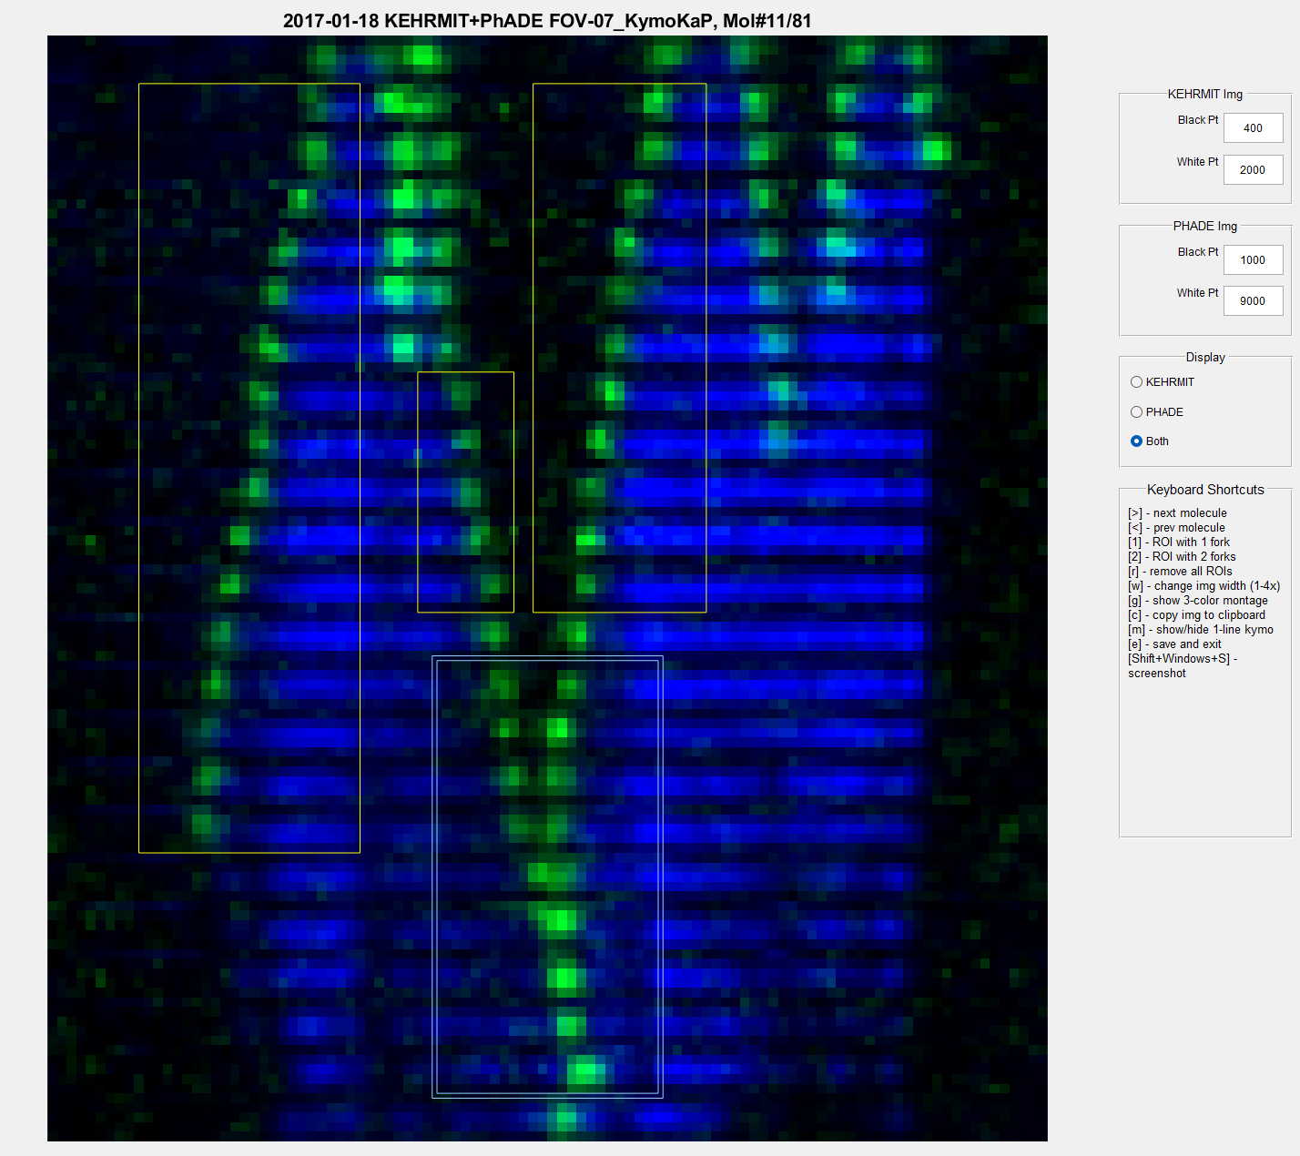
Using SelectKymoROI_KEHRMITandPHADE
Press 1 to make a rectangular Region of Interest (ROI) selection (thin green box)
Press 2 to make another type of selection (box w double-line)
To define other types of selections edit SelectKymoROI_KEHRMITandPHADE_KeyReleaseFcn

Slide 8
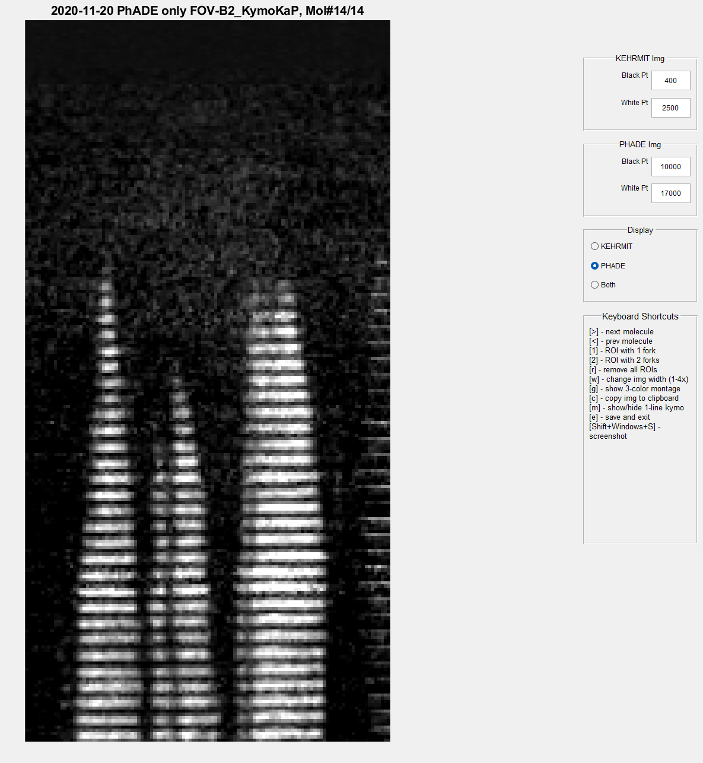
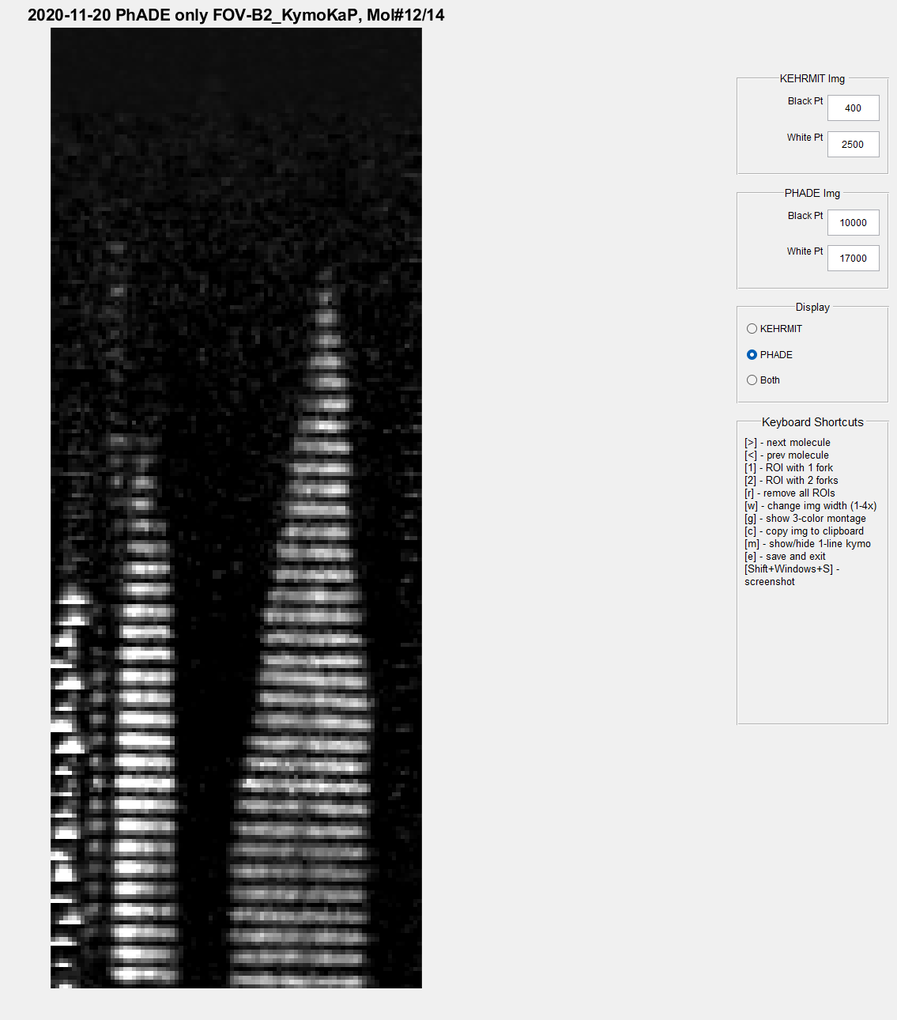
Using SelectKymoROI_KEHRMITandPHADE to view a CIDER-only kymogram

